Slide 1


TABLEAU
Presented By: Kunal Chanda(104908653)
Neha Singla(104862337)

Slide 2

Content
Introduction to Tableau
Connecting to Data Source
Data Joining and Data Blending
Visual Analytics
Calculations
Dashboard
Story
Benefits

Slide 3

What is Tableau?

Slide 4
What is Tableau?
What is Data Visualization?
Data visualization is the process of describing information through visual charts and reports.
Why is Data Visualization Needed?
It enables user to understand huge amount of data in simple and powerful visuals.
It also enables user to easily recognize patterns, trends and relations between data which might not be easily understood with the text based data

Slide 5
What is Tableau?
Tableau is a tool for visually analyzing the data and can easily connect to many data source.
Tableau gives instant knowledge by transforming data into interactive visualizations called dashboards which shows various trends and variations in the data.

Slide 6
Connecting to Data Source

Slide 7
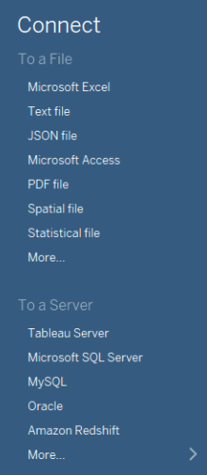
Connecting to Data Source
Tableau can connect to data sources as below:
To Local Files: Text Files, Microsoft excel, PDF Files
Server: Tableau Server, MySQL, Oracle
Cloud : One Drive, Dropbox
Connection in tableau is of two types:
Live: To a live data source
Extract: To a locally saved extract

Slide 8

Data Joining

Slide 9
Data Joining
Data Interpreter:
Delete unused rows and columns.
Make data more meaningful
Cross Database Join:
Tableau connects the data from two different files and join them to make a single table. Different kinds of join in tableau are:
Inner
Left
Right
Full Outer

Slide 10
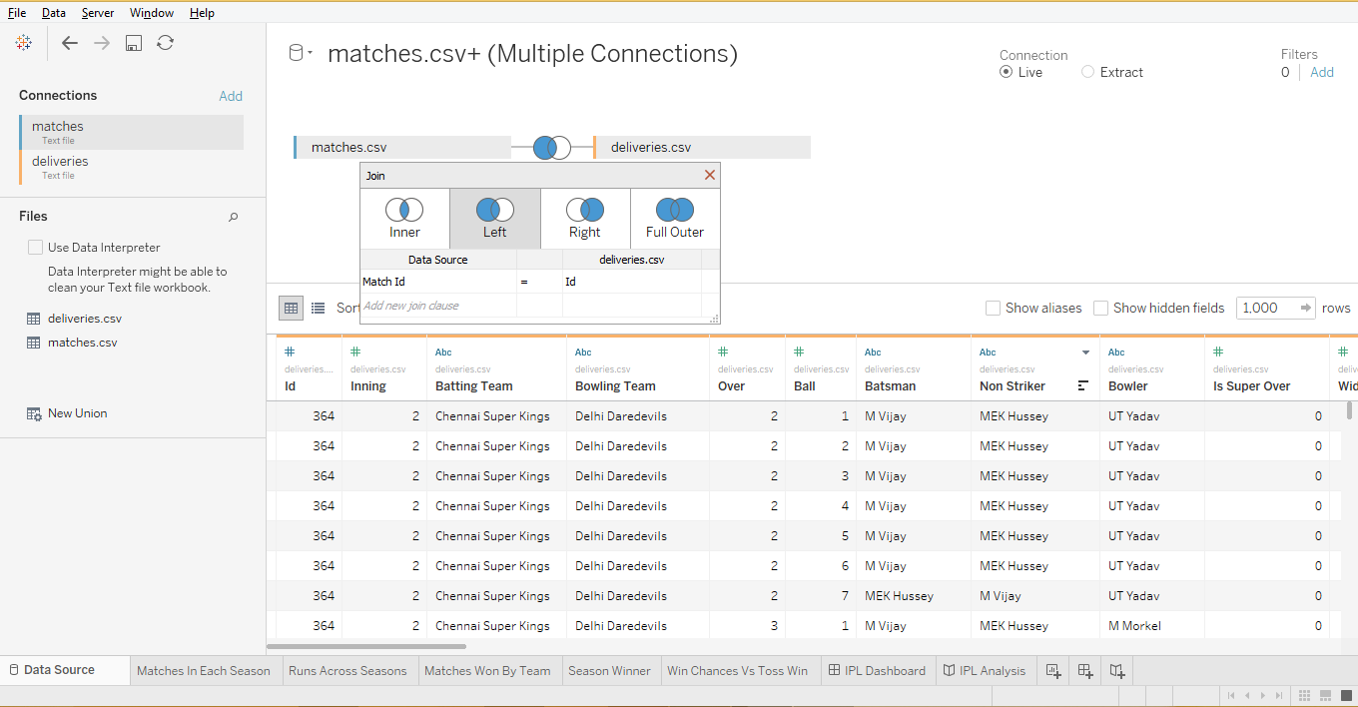
Data Joining
Joining two different data sets with a common field using joins.

Slide 11

Data Blending

Slide 12
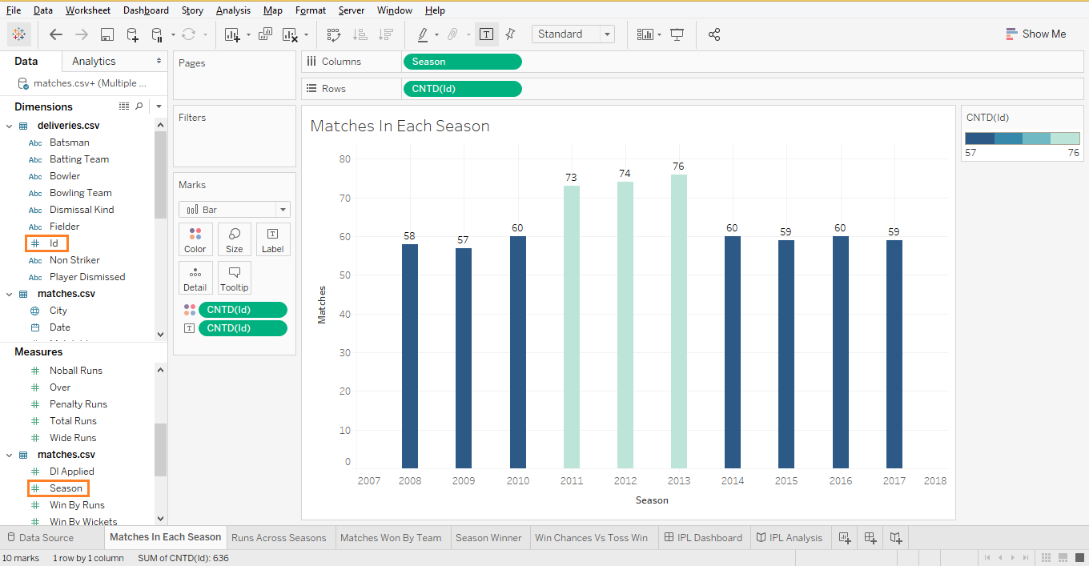
Data Blending
Connects data from different data sources and perform action on the joined database formed

Slide 13

Visual Analytics

Slide 14
Different Visual Features:
Filters Shelf: Allows user to filter data he wants to display and hide in his visualization.
Page Shelf: Enable user to better analyse the data by displaying page by page visualization depending upon the field selected.
Marks Shelf: Context can be added to the visualization by using marks with color, label, tooltip.
Sorting: Sort the visualization in ascending and descending.

Slide 15
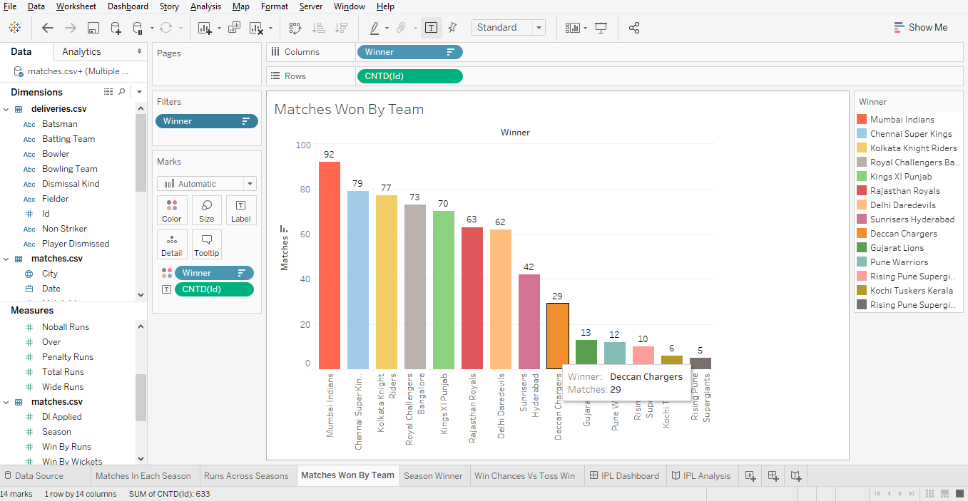
Visual Analytics
Visual Analytics

Slide 16

Calculations

Slide 17
Calculations Used
Different Visual Features:
Count Distinct: Returns the number of unique value in a field.
Percentage Of : We can calculate the percentage of our fields that we want to compare using this option.
Calculated Field: It create a custom field which involves calculations on different rows and columns.
Forecasting: It helps to find the trend or pattern in our previous data which can be implement in the future.

Slide 18
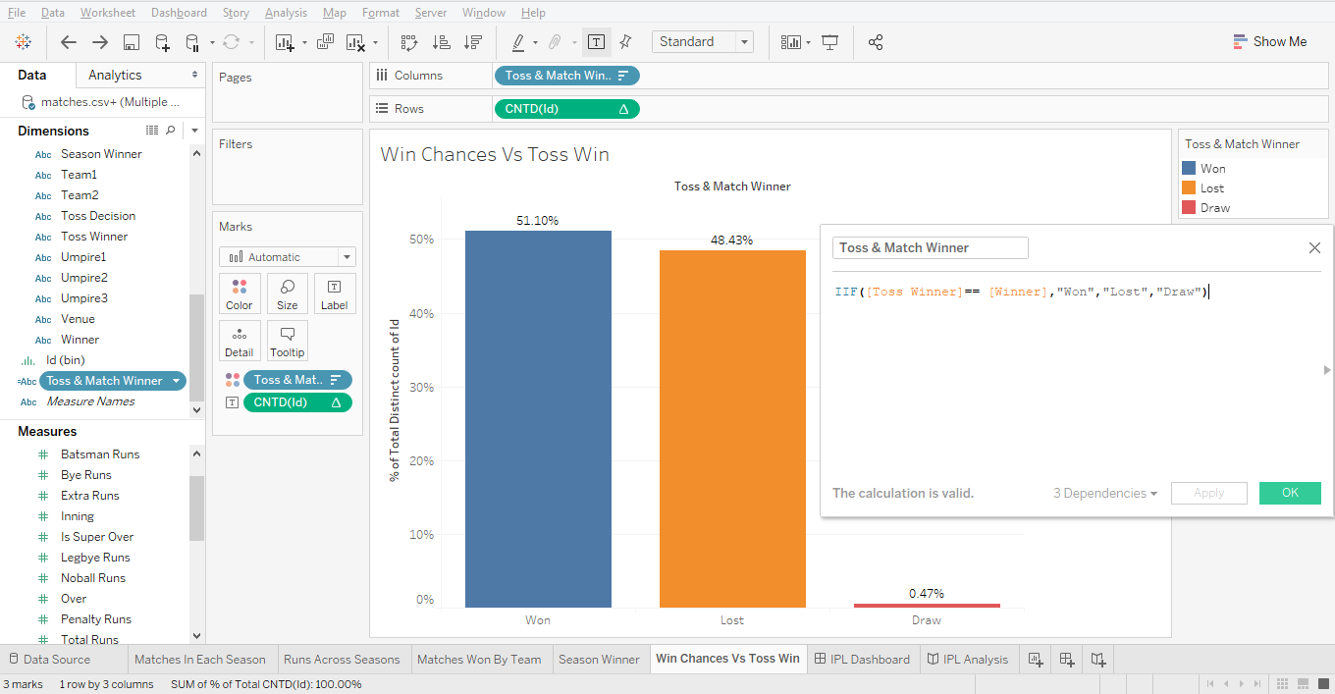
Different Calculations

Slide 19
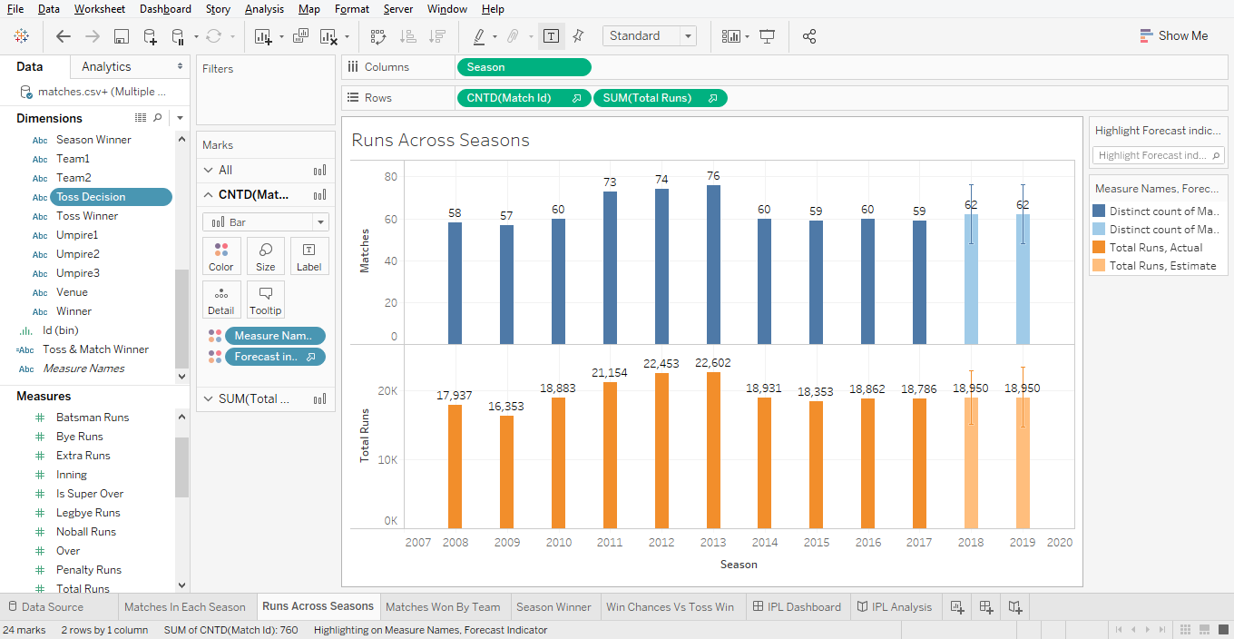
Forecasting

Slide 20
Dashboard

Slide 21
Dashboard is a collection of different worksheets being displayed on a single view.
It is an excellent tool for generic view in which we can compare and monitor variety of data of different worksheets simultaneously.
When we modify a worksheet the dashboard is updated automatically and vice versa.

Slide 22
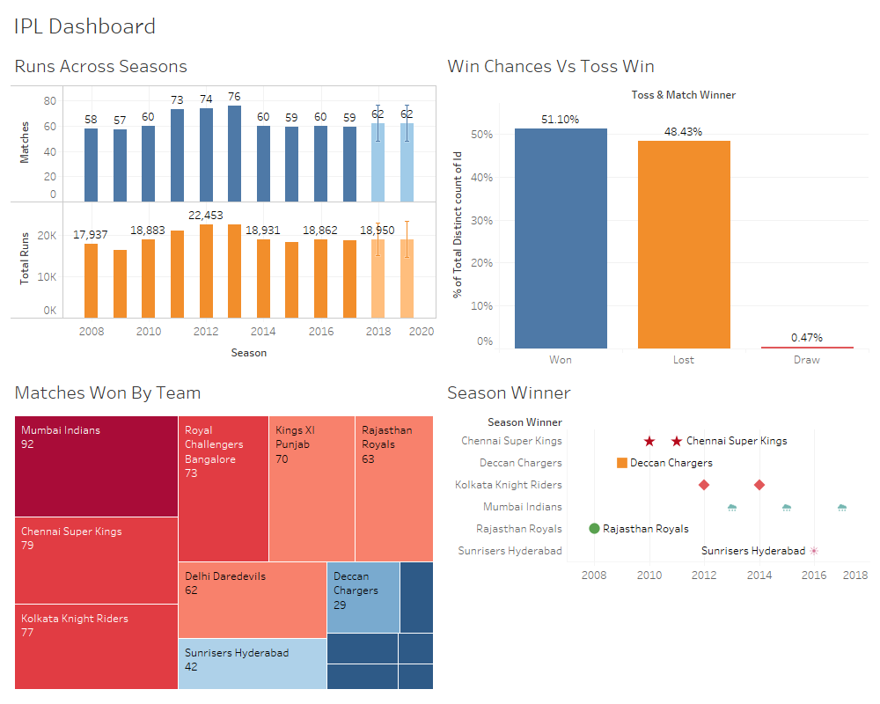
Dashboard

Slide 23
Story

Slide 24
Story
Sheet that contains a sequence of worksheets or dashboards that work together to convey information.
Powerful navigation tool for presentations.

Slide 25
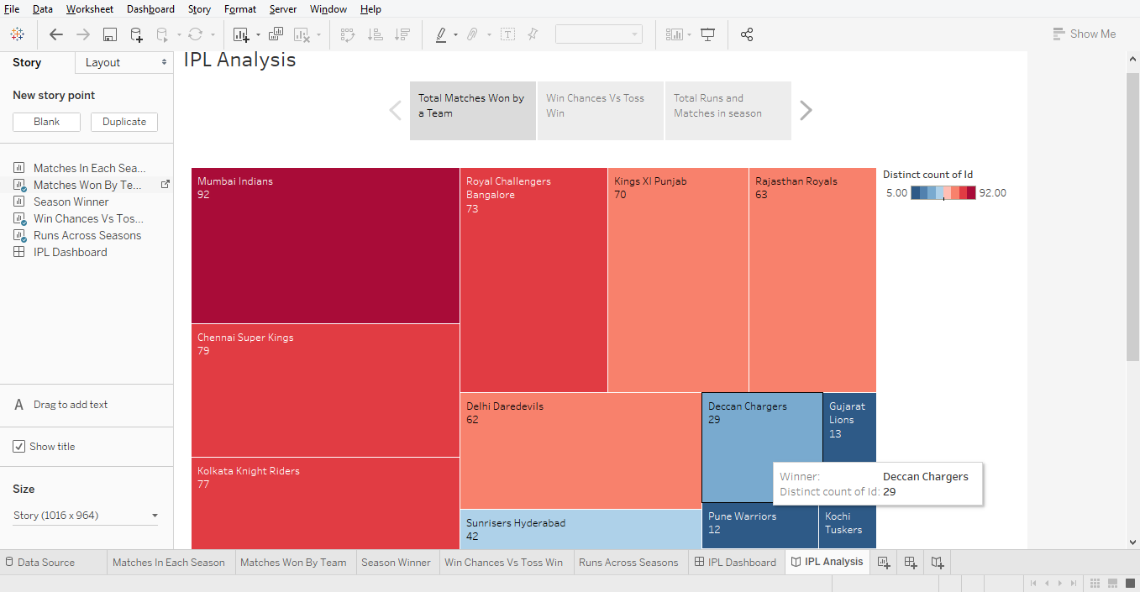
Story

Slide 26
Benefits
Tableau allows connection to a number of data sources, import and visualize data in a matter of minutes.
Tableau is incredibly easy to use, and makes it possible to bring data for analysis with few simple drag-and-drop moves.
Tableau investigates data in many different ways, starting with large, traditional dashboards, and ending up with complex cloud-based source explorations.

Slide 27
References
https://www.tutorialspoint.com/tableau/index.htm
https://www.tableau.com/learn/training
https://www.lynda.com/Tableau-tutorials/Welcome/585002/604788-4.html

Slide 28

THANKS!

